Slide 1
National Germplasm Resources Laboratory
Plant Exchange Office
John Wiersema jwiersema@ars-grin.gov
Karen Williams karen.williams@ars.usda.gov
Ned Garvey edward.garvey@ars.usda.gov

Slide 2
PEO activities
Assist in the identification and filling of NPGS germplasm needs.
Manage NPGS Plant Exploration and Exchange Program.
Develop and maintain GRIN Taxonomy.
Develop Crop Wild Relative Database.
Develop complementary ex situ/in situ collaborations with Federal land managing agencies.
Develop international collaborations in support of collection and conservation of crop genetic resources.
Facilitate NPGS international germplasm distributions and the import of genetic resources for the NPGS.

Slide 3
GRIN Taxonomy
Crop Wild Relatives (CWR) database
  Classifies CWR in relation to breeding importance
  Used by PEO to aid in identifying acquisition priorities
  3225 CWR of 116 major & minor crops in 63 genera now identified in GRIN
  CWR classification can currently be reviewed at http://www.ars-grin.gov/~sbmljw/cgi-bin/taxcwr.pl
  Seeking review and endorsement of CWR data from CGCs
  Requests for review of over 50 crops were sent to 24 Crop Germplasm Committees in early June

Slide 4
CGCs Contacted and Responded
Apple CGC
Barley CGC
Carya CGC
Crucifer CGC
Cucurbit CGC
Food Legume CGC
Grape CGC
Juglans CGC
Leafy Vegetable CGC
Maize CGC
Oat CGC
Pea CGC
Peanut CGC
Peppers CGC
Prunus CGC
Pyrus CGC
Rice CGC
Root & Bulb CGC
Small Fruits CGC
Specialty Nuts CGC
Sugarcane CGC
Sunflower CGC
Sweetpotato CGC
Tropical Fruit & Nut CGC
Notes:
The CGCs indicated here were contacted on June 6 seeking endorsement of the crop-wild-relative classifications of various crops. Responses have so far been received from those Committees highlighted in yellow.

Slide 5
Results of CGC Consultation
  Dialogue on CWR classification has been initiated with 10 of the 24 CGCs
  18 additional crops have subsequently been reviewed
  However, > 30 crops of these CGCs still lack review
  For crops of CGCs still needing review, please refer to the June 6 communication or contact John Wiersema for further information

Slide 6
Identification and filling of NPGS germplasm gaps.
This year we looked at Cucurbita (squash and pumpkins) and Cucumis (cucumber and melon) crops, prioritized NPGS need for each included taxon based primarily on:
  ease of genetic transfers using the genepool concept and taxonomic classifications.
  Current number and quality of NPGS accessions for the taxon.
  Ability to obtain additional germplasm either through exchange or explorations.
The assessment will be made available on the CGC webpage under Cucurbit CGC:
http://www.ars-grin.gov/npgs/cgclist.html#Cucurbit

Slide 7
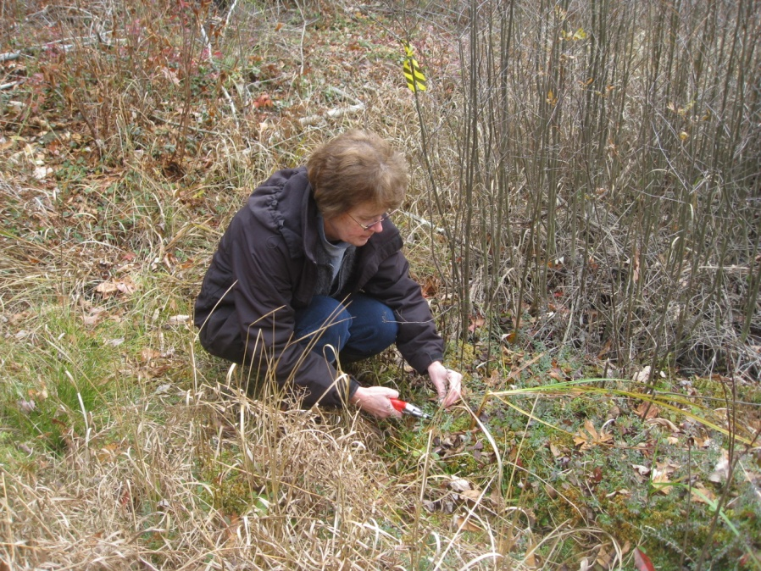
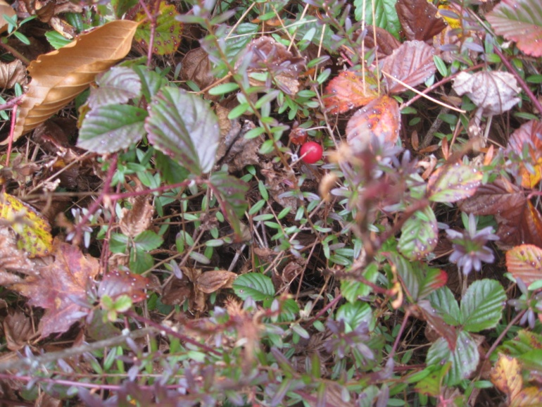
Complementary ex situ/in situ collaborations for Crop Wild Relatives native to the US.
Current project is with the US Forest Service.
In collaboration with NCGR: Corvallis and the USDA/ARS Cranberry Genetics and Genomics Laboratory
Current activity is with Cranberry (Vaccinium macrocarpon and V. oxycoccus).
Goal is to establish long-term in situ reserves which complement the NPGS ex situ collections.
FS CWR website: http://www.fs.fed.us/wildflowers/ethnobotany/wildrelatives.shtml

Slide 8
The NPGS Plant
Exploration/Exchange Program
Purpose: To fill gaps in the NPGS collections
Administration: Plant Exchange Office (PEO), National Germplasm Resources Lab
Support for both plant explorations (in situ) and plant exchanges (visits to foreign ex situ collections)

Slide 9
Proposals
separate guidelines for exploration and
exchange proposals – sent to CGCs in January
endorsement by CGC and crop curator required
accepted yearly
deadline is in July every year
funding reduced in FY 2013 and FY 2014
FY 2014 proposals currently under review

Slide 10
NPGS Plant Explorations - 2013
Fruits, nuts and woody ornamentals | Albania
Carrot | Morocco
Walnut | Kyrgyzstan
Walnut and pear | Tajikistan
Strawberry | Georgia
Magnolia asheii | United States
Begonia | United States
Sunflower | United States
Switchgrass | United States
Potato | United States
Sunflower | United States
Ash | United States
Kentucky coffeetree | United States

Slide 11
Access and Benefit Sharing for International Explorations
Prior informed consent (PIC) obtained from national authorities in all countries that are parties to the Convention on Biological Diversity (CBD)
Includes agreement on the sharing of benefits
Acceptable benefits are “in-kind” (training, equipment purchase, increase projects, etc.)
The SMTA of the International Treaty may be used to specify terms of access

