Slide 1
Welcome to the NPGS Crop Germplasm Committee Chairs Virtual Meeting
November 21, 2013
The meeting will begin at 1:30 pm EST

Slide 2
Logistics of AT&T Connect Meeting Room
Note features in the task bar at the top of the meeting room screen:
Can ask question using the raised hand feature
Step out feature if you need to take a break
Note the view pane to the right of the screen:
Can change size by dragging
Can ask question by sending note to presenter or to all
Lists the participants
Can tell who is speaking by observing the microphone icon (in
participant application only)
If using a desktop speaker phone, you may want to mute it to avoid disseminating background noise to all.

Slide 3
Speedy Introductions
State your name and employer/location
as I call the roll in alphabetical order of CGCs
(alfalfa to woody landscape)

Slide 4
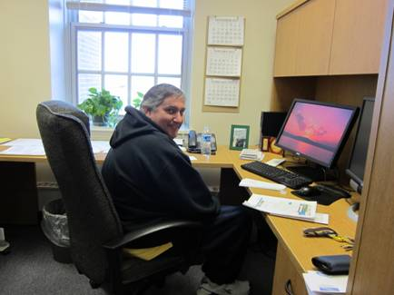
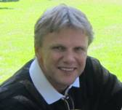
In Memory of Mark Bohning (left) and Gorm Emberland (right)

Slide 5
CGC Chair Best Practices
Submit minutes after CGC meetings, or ensure secretary does.
Ensure your membership rosters are up to date.
Notify NGRL when Chair rotates to a new member.
Notify NGRL as far in advance as possible of meeting dates.
Spearhead the revision of Crop Vulnerabilty Statements
Consider virtual technologies (such as this one) if having a difficult
time arranging well attended in person meetings.
Consider joint meetings with other CGCs based on natural
alignments and/or meeting locations

Slide 6
CGC Resources
NGRL can assist with telconferences and virtual meetings
CGC pages on GRIN help archive and display CGC information, provides continuity for chairs and members
Meetings dates and locations
Membership rosters and email addresses
Meeting minutes
Descriptor lists and reports
Crop Vulnerability Statement template
System-wide email lists for PGOC, Curators, Primaries,
CGC Chairs

Slide 7
The hill is getting steeper and the ball heavier!
Travel budgets
Demands on time
Staffing & Resources
Customer expectations
Membership pool
How can we adapt?

Slide 8
We were going to formally survey CGCs but that’s complicated. So instead, we welcome and invite your opinions on topics such as:
Frequency and method of meetings
Guidance and oversight from ARS for CGCs
Number of committees (should mergers be considered?)
Identifying and recruiting new members
Impact on quality and effective management of collections

Slide 9
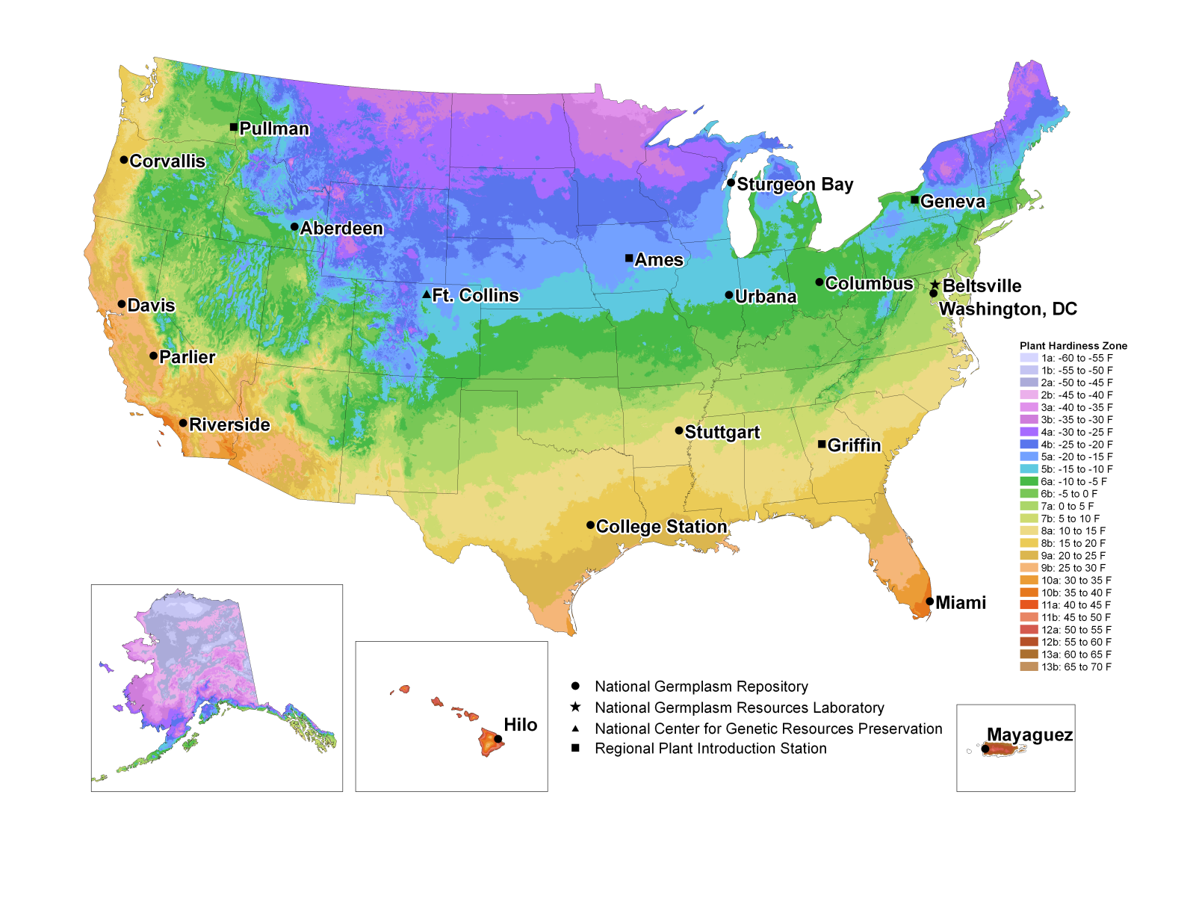
Thank you for serving as a Crop Germplasm Committee Chair. You and your 42 committees are
an integral part of the U.S. NPGS.

Slide 10
And now Peter Bretting from the ARS Office of National Programs

