Slide 1
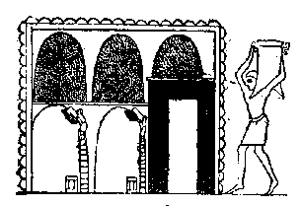
CGC Chairs Meeting, 2013 David Dierig, Research Leader National Center for Genetic Resources Preservation (PAGRPRU)

Slide 2
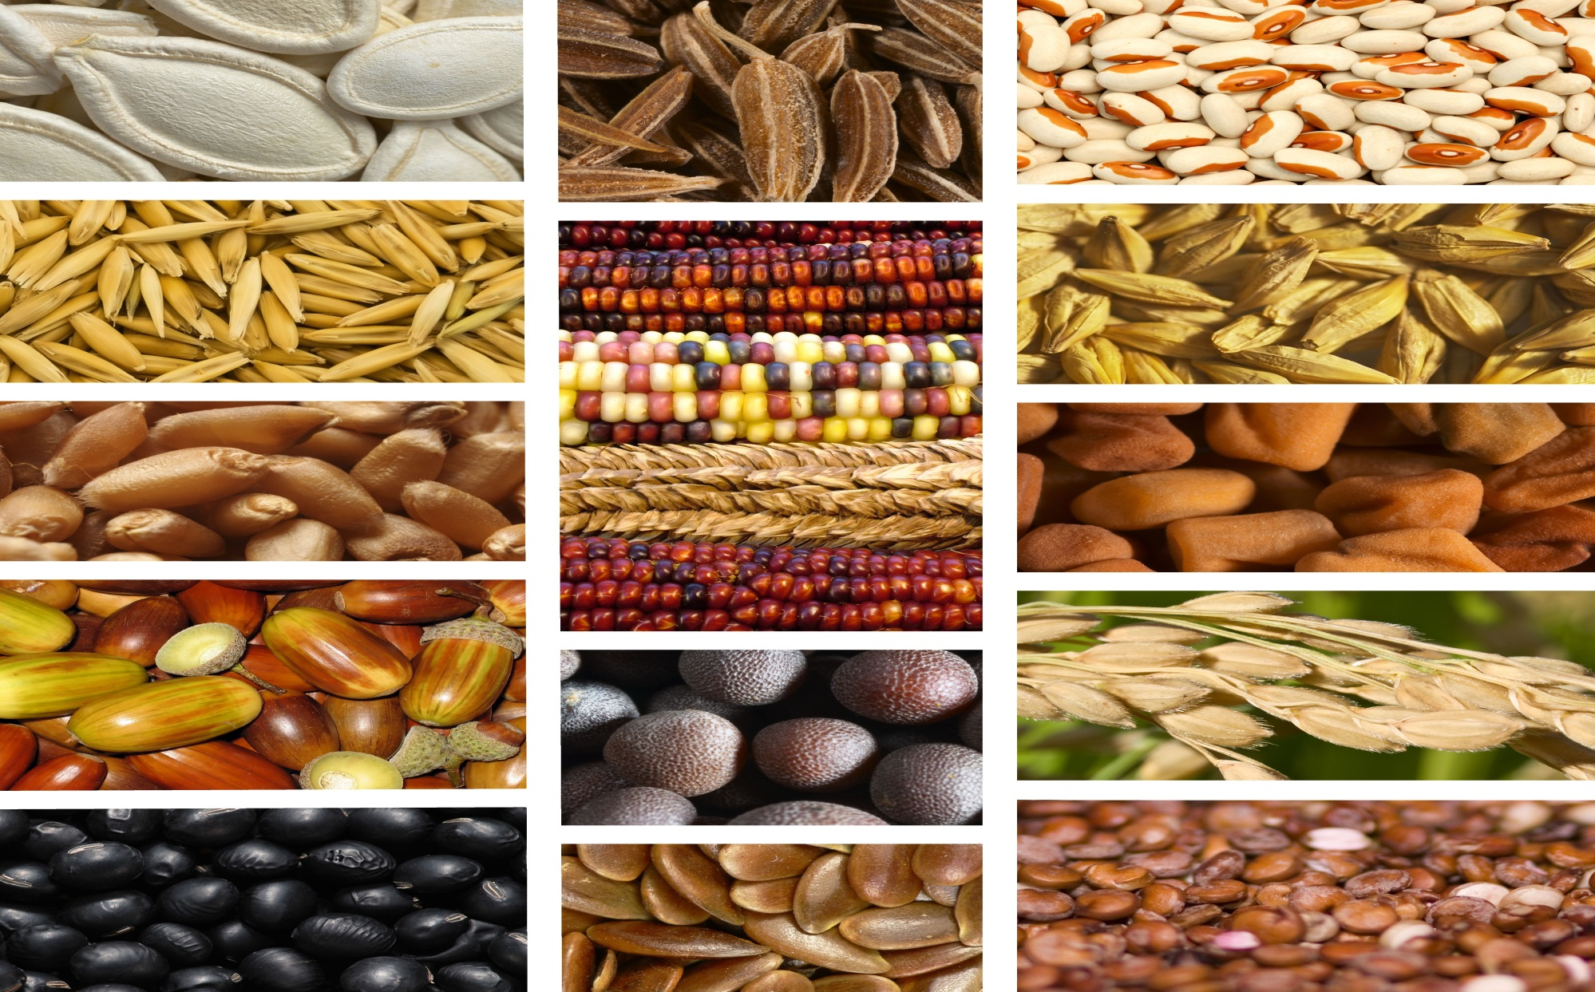
Collection Size (10/31/2013)
Total number of Samples | 925,415
NPGS Samples | 578,971
Non-NPGS Samples* | 346,444
Number of Genera | 2,220
Number of Species | 13,209
Number of Accessions | 533,655
*includes PVP, Security Backup, Quarantine, inactive inventory

Slide 3
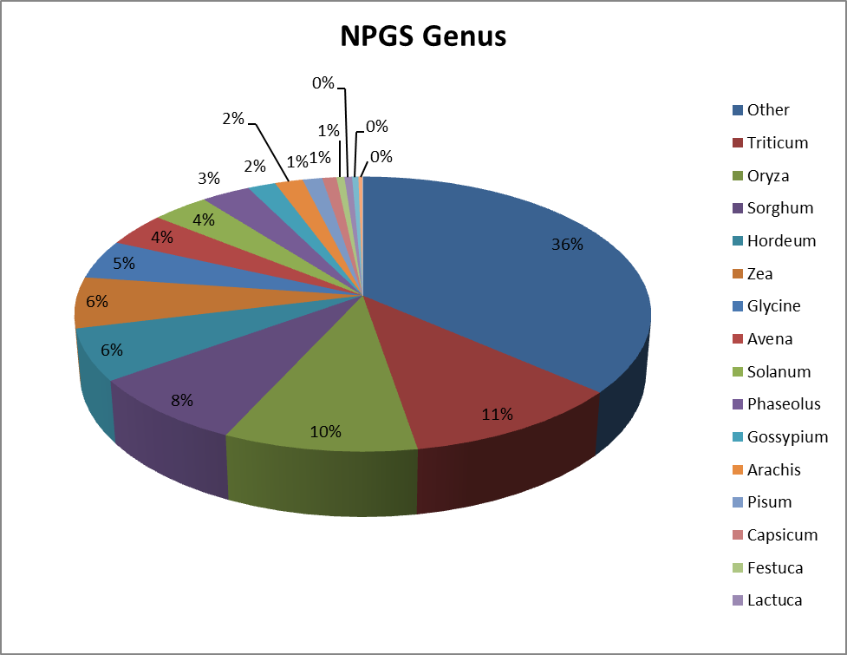
Individual Collection Sizes

Slide 4
Crop | Accessions in Storage
Wheat | 59,442
Rice | 18,313
Sorghum | 44,151
Corn | 15,264
Beans | 18,313
Cotton | 6,203

Slide 5
NPGS sites % backed up at NCGRP

Slide 6
NCGRP 5 year history Germination and Monitor Tests
Notes:
High numbers were seen in 2009 and 2010 due to a high number of wheat samples received (>11000). These are fast and easy to do so numbers are elevated

Slide 7
5 year history of Svalbard Shipments 83,784 total NPGS samples

Slide 8
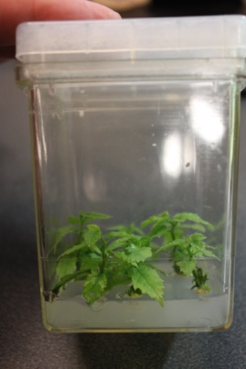
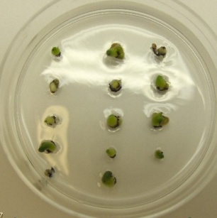
FY13 Clonal Collections in Cryopreservation
 | Genus | No. of accessions
1 | A. sativum | 3
2 | Cynodon | 4
3 | Fragaria | 35
4 | Humulus | 3
5 | Ipomoea | 17
6 | Musa | 5
7 | Pyrus | 5
8 | Rubus | 27
9 | Saccharum | 9
10 | S. tuber. PVPO | 22
11 | S. tuberosum 'wild' species | 9
12 | Vaccinium | 9
13 | Malus | 20
 | Total | 168
CryoVeg FY13 sum

Slide 9
NPGS Accessions in Cryopreservation as of 9/30/13
Type of tissue | Number of
 | Genera | Species | Accessions
Shoot tips | 18 | 151 | 1,680
Dormant buds | 3 | 61 | 2,357
Total NPGS | 21 | 212 | 4,037
Malus DB (Canada, black box) |  |  | 302
NPGS has ca. 30,000 clonal accessions (5.3 % in the total No. of acc. of 562,559; GRIN 040513)
Cryopreserved at PAGRPRU: 4,037 accessions
13.5 % of all clonal accessions,
5.6 % via shoot tips,
7.9 % via DB

Slide 10
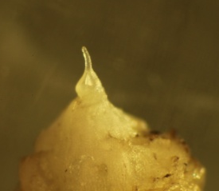
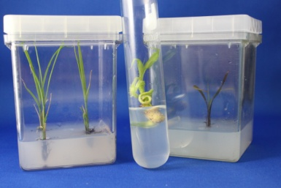
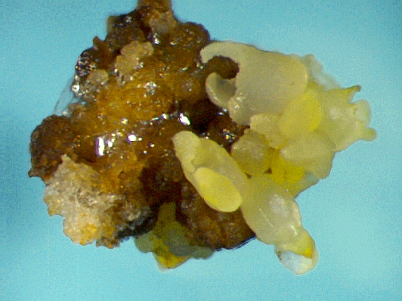
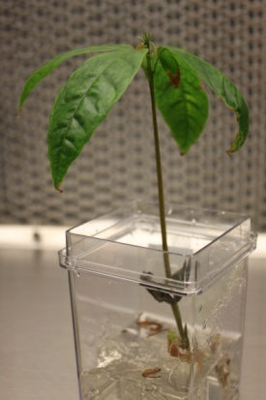
FY14 Clonal Collections for Applied Cryo
Ananas
Ipomoea batatas
Musa
Rubus
Saccharum
Solanum tuberosum PVP
Solanum 'wild' species
FY 14 ‘Research’ Species
Prunus armeniaca
P. dulcis
P. persica
Theobroma cacao

Slide 11
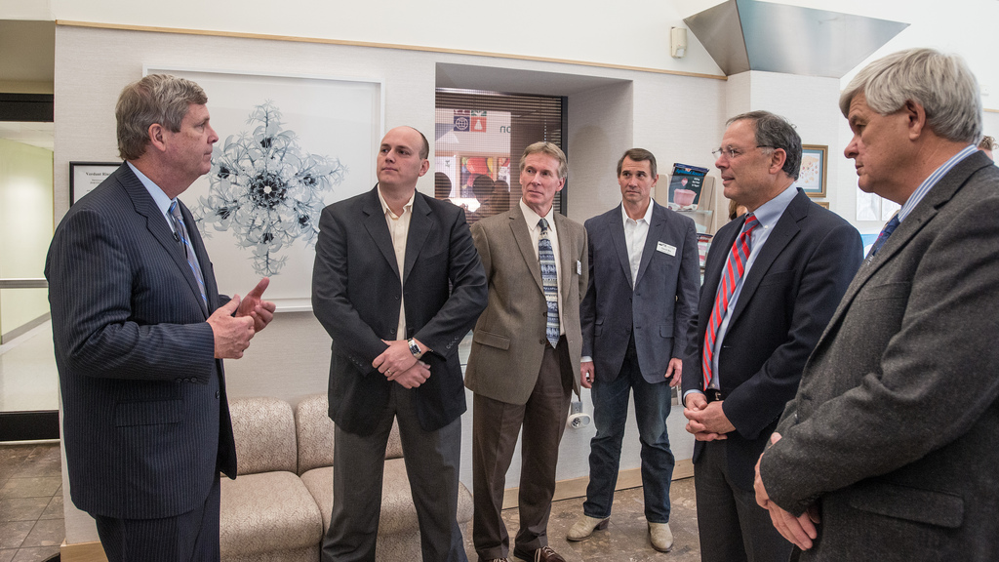
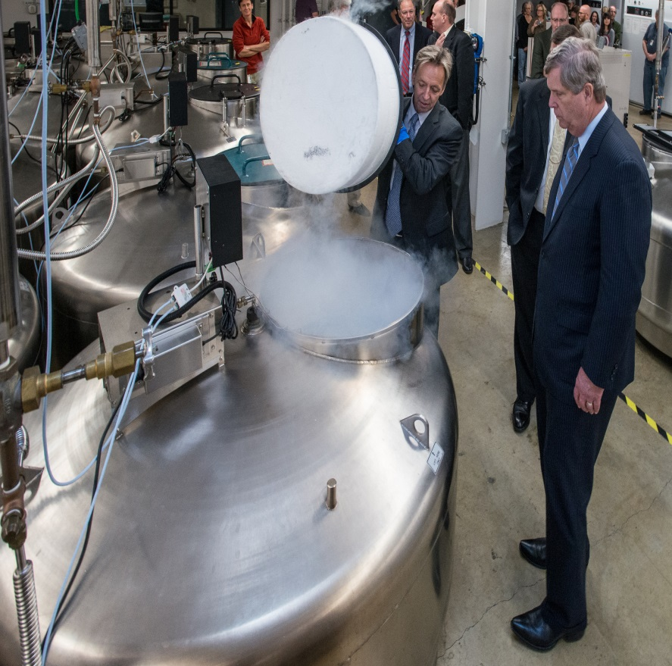
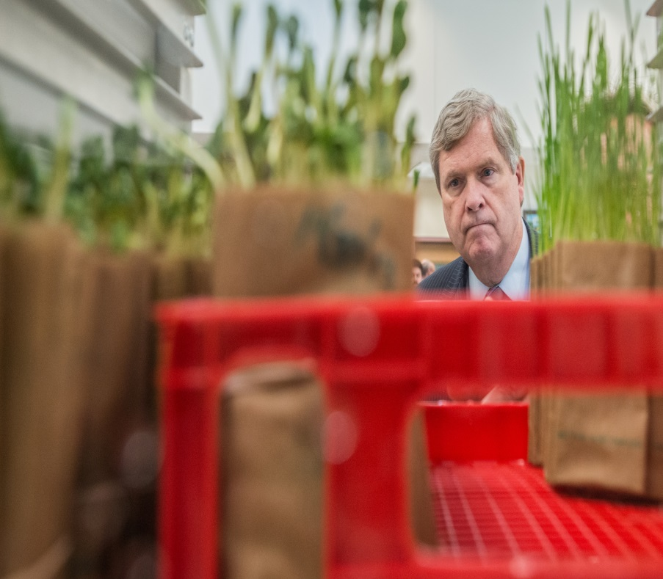
Visit to NCGRP by Secretary Vilsack November 6, 2013

